Slide 1
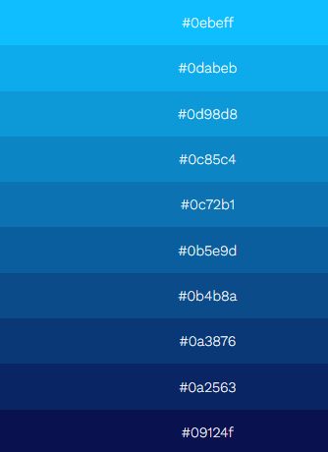
Site Usado: https://photokit.com/colors/color-gradient/?lang=pt

